Slide 1


Slide 2

Novel Issues in Canada Affecting Cross-Border Insolvencies:
Reverse Vesting Orders and the Pension Bankruptcy Protection Bill
  Valerie Cross, Maria Konyukhova, Toni Vanderlaan, Frank Vazquez and Adam Swick

Slide 3





Panelists
Valerie Cross
Dentons
Partner
Toronto & Vancouver
Maria Konyukhova
Stikeman Elliott
Partner
Toronto
Toni Vanderlaan
Deloitte
Partner & Leader
Toronto
Frank Vazquez
Norton Rose Fulbright
Senior Counsel
New York
Adam Swick
Akerman
Special Counsel
Austin

Slide 4
Overview
View from Canada
        Reverse Vesting Order background
        Test
        Issues
Reaction in the US
    Challenges to recognition
    Reported decisions
    Texas two-step
    Other issues
Pensions

Slide 5
Reverse Vesting Orders
(“RVOs”)

Slide 6
What is an RVO?
  Traditional approach:
  Sale of assets: purchaser obtains a vesting order, stating debtor’s assets are purchased free and clear, leaving liabilities and encumbrances behind
  Plan of arrangement: creditors vote to approve a plan, accepting less than full repayment of their debts
  With reverse vesting orders:
  purchaser becomes the sole shareholder of the debtor;
  debtor retains certain assets; and
  liabilities not being assumed are vested out and transferred, together with any excluded assets, into another entity (“ResidualCo”)
  Just Energy Group Inc. et. al. v. Morgan Stanley Capital Group Inc. et. al., 2022 ONSC 6354 at para. 27

Slide 7
Current Test
Harte Gold Corp. (Re), 2022 ONSC 653
  Why is the RVO necessary?
  Does the RVO structure produce an economic result at least as favourable as other viable alternatives?
  Is any stakeholder worse off under the RVO structure than they would have been under any other viable alternative?
  Does the consideration being paid for the debtor’s business reflect the value of the intangible assets being preserved under the RVO structure?

Slide 8
Why Use an RVO?
  Sale of shares versus assets
    Transfer of assets that are not readily transferrable outside of a share sale:
      Permits
      Licenses
      Non-transferable assets or rights (e.g., mineral and mining rights)
      Tax attributes
  Speed

Slide 9
Use of RVOs
  Restructurings under the Companies’ Creditors Arrangement Act (“CCAA”)
  RVOs outside of CCAA restructurings
    Vert Infrastructure Ltd. (Re), (8 June 2021), Toronto CV-20-00642256-00CL (Ont Sup Ct [Comm List])
    Forage Subordinated Debt LP III v. Enterra Feed Corporation et. al., (2 March 2023), ABKB, 2201-012935

Slide 10
Authority
  CCAA:
    Section 11 (Harte Gold)
    Section 36
  Canada Business Corporations Act, R.S.C. 1985, c. C-44
    Section 192 (Xplore Inc. (Re), 2024 ONSC 5250)
  Bankruptcy and Insolvency Act, R.S.C. 1985, c. B-3 [BIA]:
    Section 183 (PaySlate Inc. (Re), 2023 BCSC 608)
    Section 65.13 (Proposition de Brunswick Health Group Inc., 2023 QCCS 4643)
    Section 243 (British Columbia v. Peakhill Capital Inc., 2024 BCCA 246)

Slide 11
Different Steps Involved with RVOs
    What assets are not readily transferrable?
    What potential benefits are there from a non-asset sale?

Slide 12
Current Test
Harte Gold Corp. (Re), 2022 ONSC 653
  Why is the RVO necessary?
  Does the RVO structure produce an economic result at least as favourable as other viable alternatives?
  Is any stakeholder worse off under the RVO structure than they would have been under any other viable alternative?
  Does the consideration being paid for the debtor’s business reflect the value of the intangible assets being preserved under the RVO structure?

Slide 13
Emerging Issues
    Jurisdiction
    Assigning Contracts
    3. Overuse

Slide 14
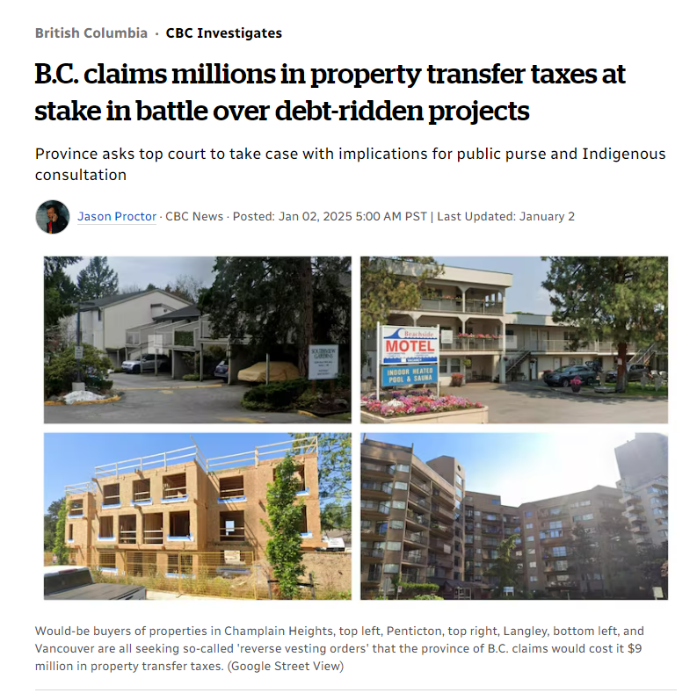
British Columbia v. Peakhill Capital Inc.,
2024 BCCA 246 (under appeal)
  Jason Proctor, “B.C. claims millions in property transfer taxes at stake in battle over debt-ridden projects”, CBC News (2 January 2025), online.

Slide 15
British Columbia v. Peakhill Capital Inc.,
2024 BCCA 246 (under appeal)
  RVOs in receiverships
  RVOs can be granted in receiverships: BIA, s. 243
  No reason an RVO is not incidental or ancillary to a receiver’s power to sell
  RVOs to avoid attracting property transfer tax (“PTT”)
  Structuring a transaction to avoid the transfer of title and PPT is a legitimate commercial practice in non-insolvency context
  The goal of maximizing recovery for creditors is a bona fide purpose

Slide 16
In the Matter of CannaPiece Group Inc.,
2023 ONSC 841
  Parties submitted RVO was needed to preserve the going-concern value and cannabis licenses
  ONSC denied the RVO:
  RVO would result in vesting out and extinguishing first priority lender’s security
  The first secured lender did not consent
  Overall equities and stakeholder interests did not favour RVO

Slide 17
PaySlate Inc. (Re), 2023 BCSC 608
  Factors to consider:
  Extraordinary circumstances must exist
  Creditors should have an opportunity to have a voice
  Courts should be aware that RVOs remove the opportunity for negotiations that may lead to compromise and greater value for a broader group of creditors
  An evidence-based rationale should explain why the RVO is at least equivalent to outcomes under the statutory mechanisms
  In Payslate:
  Lack of service on unsecured creditors
  Insufficient evidence

Slide 18
Good Natured Products Inc. (Re)
  Court-approved sales agent fee with a first-ranking charge
  Proposed RVO would pay sales agent $315,000, not 3% value
  Sales agent and monitor opposed the RVO
  “In my view, it would be morally and commercially repugnant for those stakeholders to now disregard the means by which that successful solution was found and the price that they agreed to pay for that effort. In addition, in my view, it would offend the conscience of the Court – if not constitute an error of law – to endorse such an ex post facto balancing approach that would void protections granted by this Court and would result in such unfairness.”: para. 76

Slide 19
Challenges to Recognition

Slide 20
Recognition of RVOs in U.S. Proceedings
  Acerus Pharmaceuticals Corp.
  Just Energy
  Dynamic Technologies Group Inc.
  NextPoint Financial
  Black Press
  Good Natured

Slide 21
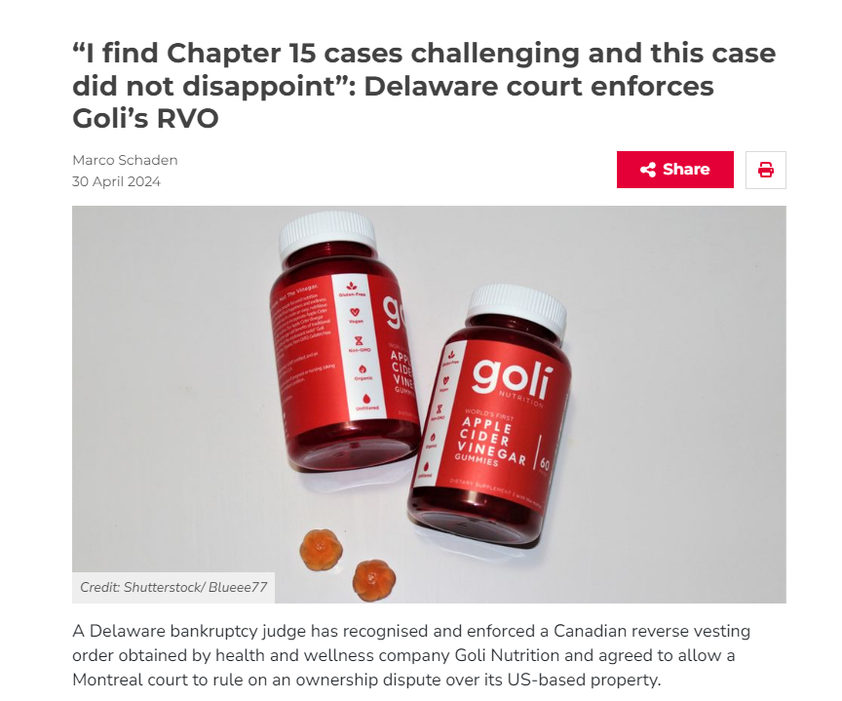
Reported Decisions Discussing RVOs
  In re Goli Nutrition Inc., Case No. 24-10438 (LSS)
  (Bankr. D. Del.)
Marco Schaden, ““I find Chapter 15 cases challenging and this case did not disappoint: Delaware court enforces Goli’s RVO”, Global Restructuring Review (30 April 2024), online.

Slide 22
How does an RVO differ from a Texas Two-Step?
  Use
  RVOs: typically granted in instances of non-transferrable licenses, assets and tax benefits
  Texas Two-Steps: used for companies facing mass tort claims (e.g., asbestos)
  Mechanism
  RVOs: purchaser acquires debtor company through a share purchase agreement
  Texas Two-Steps: a company undergoes a divisive merger to create two separate corporate entities → liabilities are transferred to one entity, which files for bankruptcy, while the other entity continues operating
  Judicial scrutiny
  RVOs: should not be the norm – careful scrutiny required to ensure they are fair and reasonable to all parties since they bypass insolvency provisions aimed at giving creditors a say (Payslate)
  Texas Two-Steps: funding agreements may prevent a company from establishing a good-faith filing

Slide 23
Emerging Issues: U.S. Recognition of RVOs
  Possibility of a U.S. court concluding an RVO should not be granted recognition under Chapter 15
  Delaware limiting relief that can be sought in the US in recognition proceedings
    Black Press

Slide 24
Emerging Issues: U.S. Recognition of RVOs
  Treatment of third-party releases?
  Complex uses of RVOs?
  Other tools available to recognize an RVO?

Slide 25
Pensions

Slide 26
Background to Bill C-228
  Declining number of defined benefit plans in Canada
    2019: 9341
    2023: 8510
  Number of Canadians with defined benefit pension plans has grown
    2021: 4.5 million
    2022: 4.7 million
    Growth related to public section
  Funding ratio
    March 2019: ~80%
    End of 2024: 105.5%

Slide 27
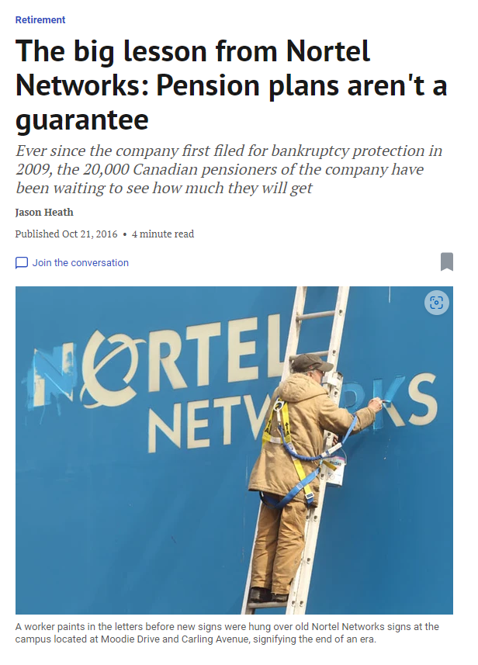
Background to Bill C-228
  Crisis of underfunded pension obligations
    Nortel, Indalex, Sears and others
  Four-year delay to account for discussions and planning between companies and lenders
Jason Heath, “The big lesson from Nortel Networks: Pension Plans aren’t a guarantee”, The Financial Post (21 October 2016), online.

Slide 28
Background to Bill C-228
  The Pension Protection Act, S.C. 2023, c. 6 [PPA] received assent on April 27, 2023
  New legislation amends the following to afford greater protection to members of defined benefit pension plans:
    the BIA;
    the CCAA; and
    the Pension Benefits Standards Act, 1985, R.S.C. 1985, c. 32 (2nd Supp.)
  PPA grants super-priority status to deficits under defined benefit pension plans in employer insolvency proceedings
  Transitional provisions under the PPA provide for a four-year interim period prior to the amendments coming into force

Slide 29
Legislative Changes under Bill C-228
  Previously, the BIA and CCAA provided for super-priority status for:
    Amounts deducted from an employee’s remuneration for payment to the fund;
    “Normal costs” and defined contributions required to be paid by the employer to the pension fund; and
    Amounts required to be paid by the employer to the administrator of a pooled registered pension plan.

Slide 30
Legislative Changes under Bill C-228
  The PPA amends the BIA and the CCAA to add super-priority status to two additional liabilities:
    Amounts equal to “special payments” an employer must pay under s. 9 of the Pensions Benefits Standards Regulations, 1985, to liquidate an unfunded liability or a solvency deficiency; and
    Any amount required to liquidate any other unfunded liability or solvency deficiency of the fund. This liability is determined at the time the notice of intention or the proposal is filed.
  “Unfunded liabilities”: determined on a going-concern basis
  “Solvency deficiencies”: determined on a solvency basis

Slide 31
Legislative Changes under Bill C-228
  These new amounts will also rank above every other claim, right, charge or security against the bankrupt’s assets, regardless of when that other claim, right, charge or security arose, except for certain specified claims
  A court will not approve a proposal or a plan for an employer who participates in a registered defined benefit pension plan unless it is satisfied that the proposal or plan of arrangement appropriately provides for the payment of these funds (ss. 2 and 5 of the PPA)

Slide 32
Potential Effects under the PPA
  Pension deficit liabilities are only ascertainable at the time insolvency proceedings are initiated – rather than at the time of financing
  Lenders may increase restrictions or costs for companies seeking financing
    Review portfolio
    Consider the reporting requirements for borrowers
    Impose tailored financial covenants
  Companies may terminate or convert their defined benefit pension plans
    Alternative retirement savings schemes
    Negotiate changes to collective agreements
    De-risk defined benefit plans

Slide 33
Thank you

